Slide 1
Predicting Smoker Status
Emerie Danson, Sam Mathieu, Eve Dean
Notes:
https://slidesgo.com/theme/smoke-social-media#search-smoking&position-1&results-4&rs=search&rs=search

Slide 2
Overarching Question
Using health variables as predictors, are we able to predict smoker status?

Slide 3
Project Overview
Explore and visualize the dataset
Balance data and add feature engineering
Develop logistic regression and nearest neighbors models
Use coefficients from logistic regression to finetune models
Develop and finetune decision trees and gradient boosting
Ensemble the three model types with a voting classifier

Slide 4
About the Data
Kaggle dataset using data from the Korean Government
Includes several physiological measurements
height, weight, hearing, eyesight, blood pressure
hemoglobin, urine protein, cholesterol + more
Dental caries, tartar
26 columns, 55692 rows of data after cleaning

Slide 5
Data Exploration & Visualization

Slide 6
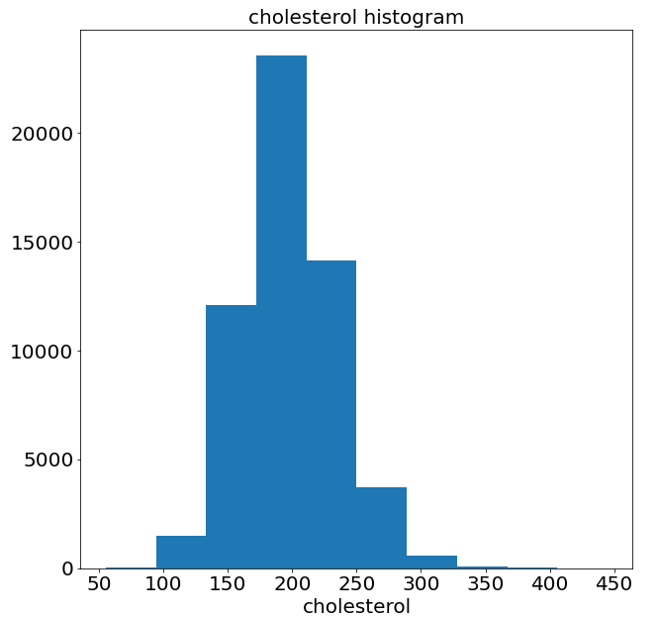
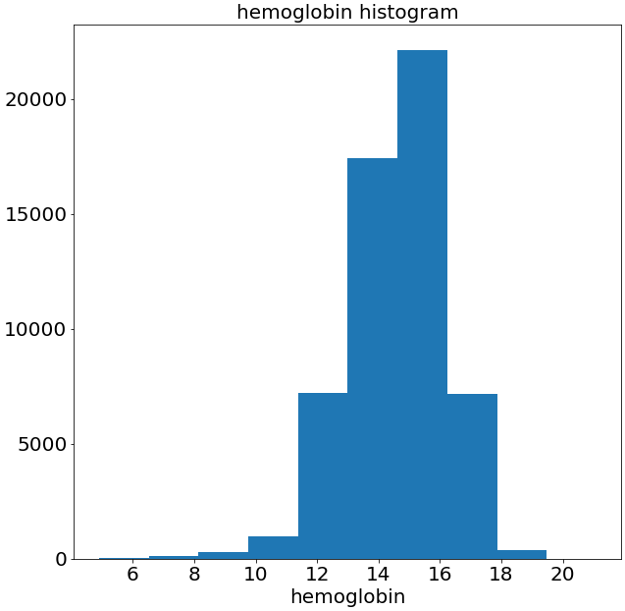
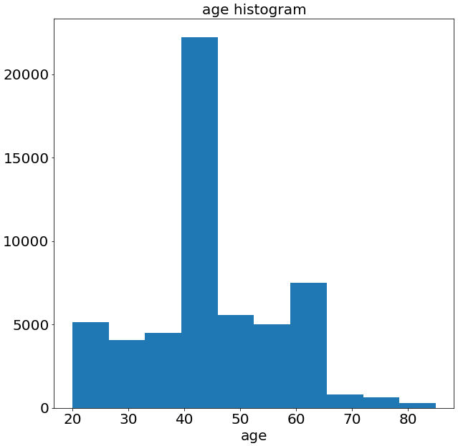
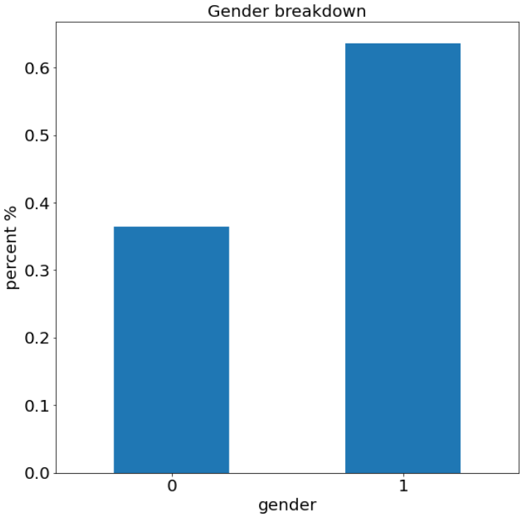
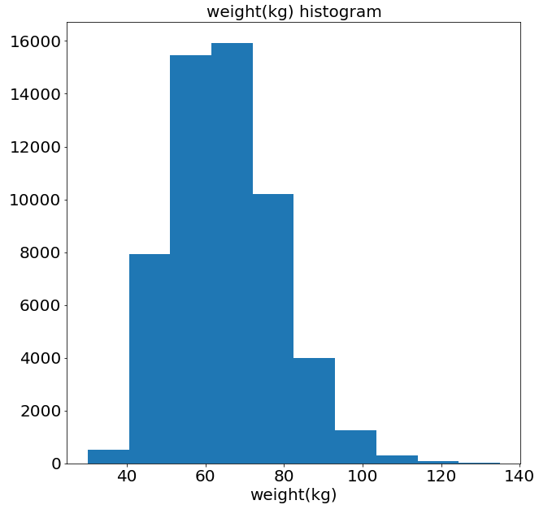
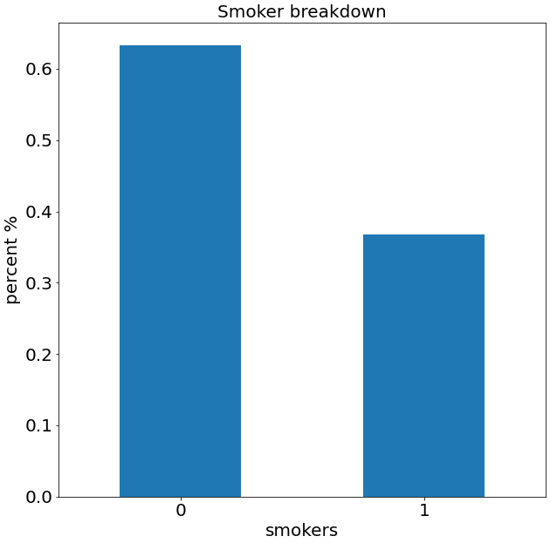
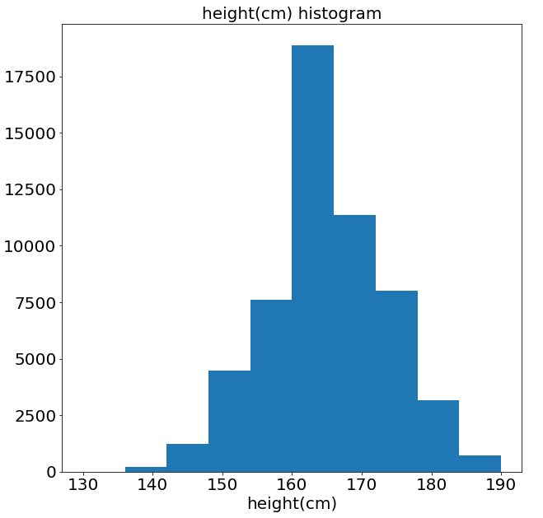
Data Visualization
~37% are smokers
~36% are female
40-45 years old significantly overrepresented
Continuous variables are normally distributed
Other conditions categorical
Notes:
Eve

Slide 7
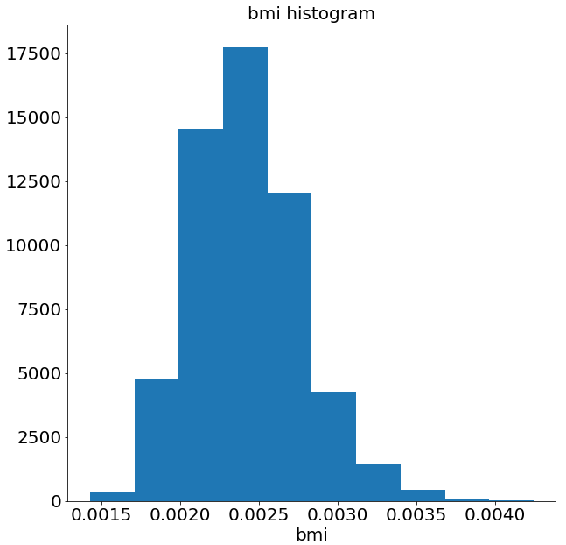
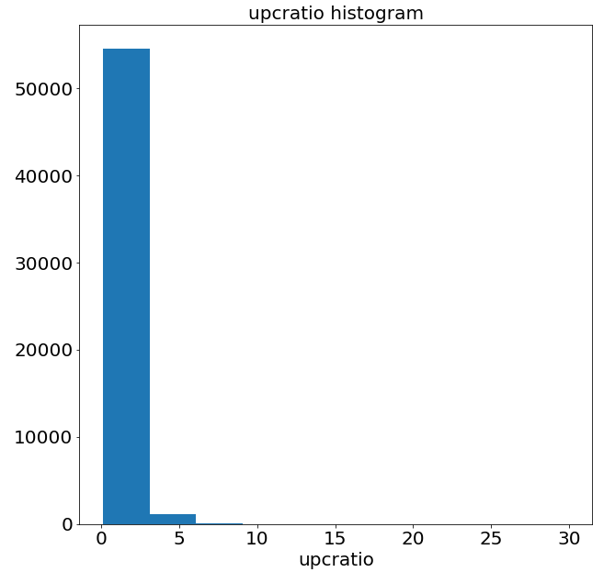
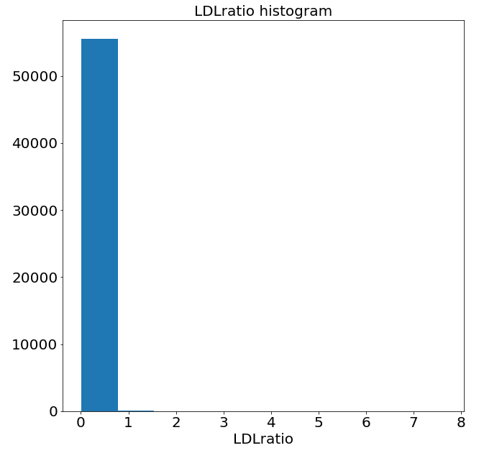
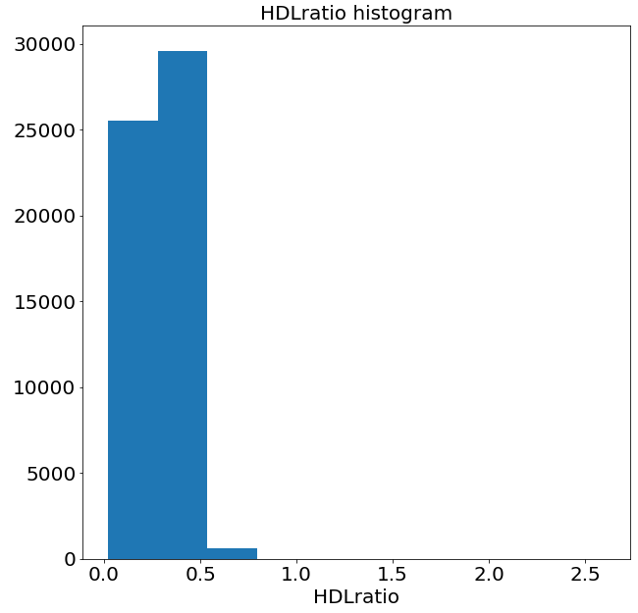
Feature Engineering
BMI : body mass index
weight/height**2
Healthy range: 18.5 to 24.9
Upc ratio :
urine protein / serum creatinine
Healthy range: < 0.2
LDL ratio: “bad cholesterol”
Healthy range: < 0.5
HDL ratio: “good cholesterol”
Healthy range: > 0.3

Slide 8
Data Balancing
Given the higher percent of non-smokers, we balanced the data in the training and testing set
Balanced smokers and non-smokers 50/50
Training set 70%
Test set 30%
Notes:
Emerie

Slide 9
Logistic Regression and Nearest Neighbors

Slide 10
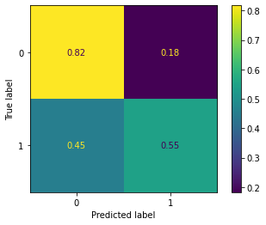
Initial logistic regression model
Precision: 0.76
Accuracy: 0.72
Logistic model including all variables in the dataset
Decent initial precision and accuracy
There is room for exploring how new variables may improve the true positive

Slide 11

Initial nearest neighbor classifier
Precision: 0.74
Accuracy: 0.72
Similar to the logistic regression
Decent precision and accuracy
Still room for improvement…

Slide 12
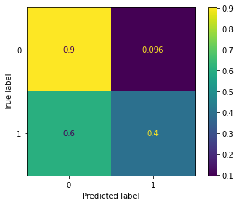
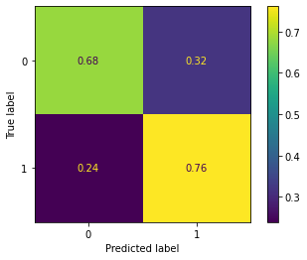
Logistic regression model and nearest neighbors with new variables
Accuracy: 00.68
Precision: 0.75
Accuracy: 0.71
Columns added:
BMI
UPC ratio
LDL ratio
HDL ratio
Logistic
KNN

Slide 13
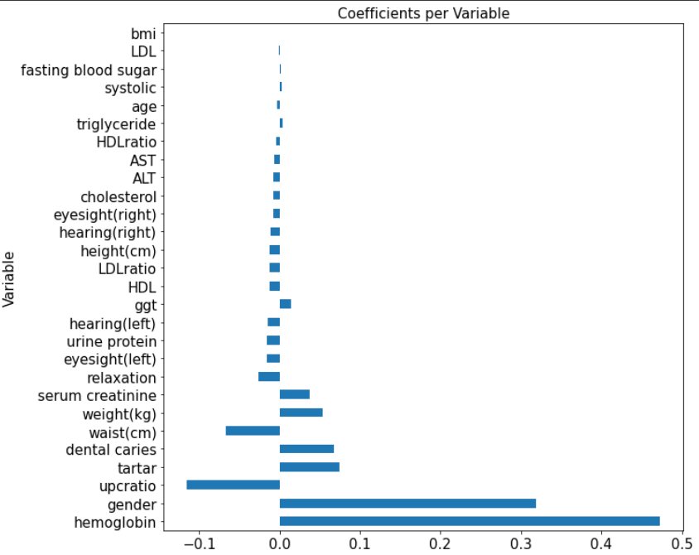
Logistic Regression Coefficients
±0.05 cutoff includes:
Hemoglobin
Gender
UPC Ratio
Tartar
Dental Caries

Slide 14
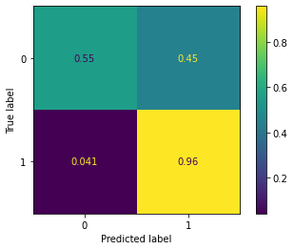
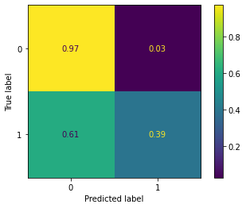
Models only including highest coefficients
Nearest Neighbors
Logistic
Precision: 0.98
Accuracy: 0.65
Accuracy: 0.65
Neighbors: 50

Slide 15
Decision Trees

Slide 16
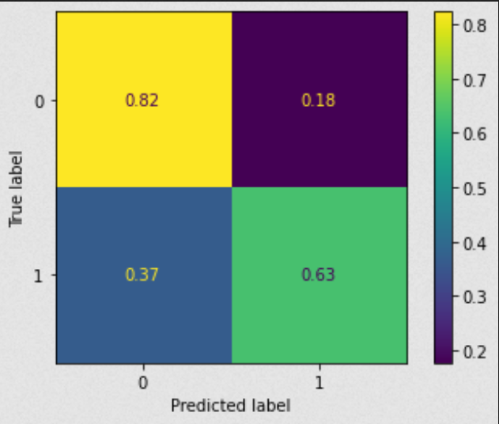
Decision tree without balancing or new feature engineering
70/30 train test split
Max depths: [2, 5, 10, 25, 50]
Min sample splits: [2, 5, 25, 50, 100]
Min sample leaves: [2, 5, 25, 50, 100]
The best model had the following parameters:
Max depth = 25
Min sample split = 2
Min sample leaf = 2
Accuracy score: .7542

Slide 17
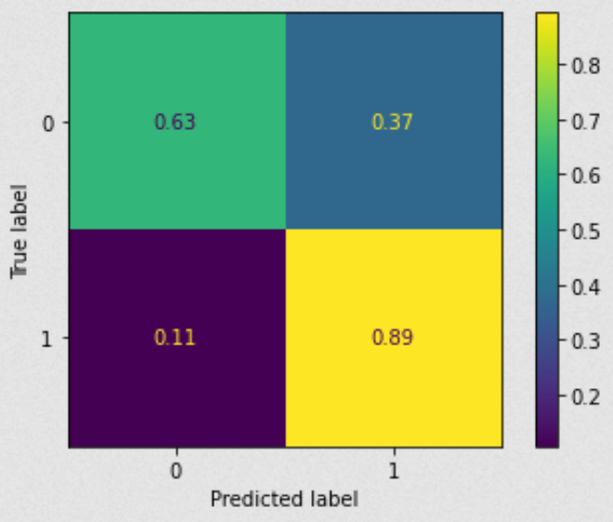
Balanced Train/Test without new features
The following parameters gave the “best” score:
Max depth = 6
Minimum sample split = 2
Minimum sample leaf = 37
Best score: .76

Slide 18
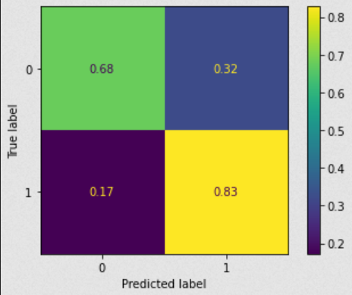
Balanced Train/Test with new features
ID variable is now removed
The following parameters gave the “best” score:
Max depth = 10
Minimum sample split = 50
Minimum sample leaf = 10
Accuracy score: .71

Slide 19
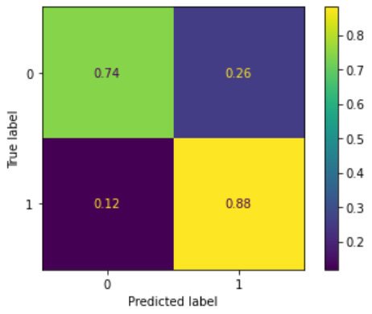
Gradient boosting (balanced, train test split, new features)
The following parameters gave the “best” score:
Number of estimators: 200
Learning rate: .075
Max depth: 10
Accuracy score: .774
Improved true negative and true positive predictions

Slide 20
Ensembling
Notes:
Emerie

Slide 21
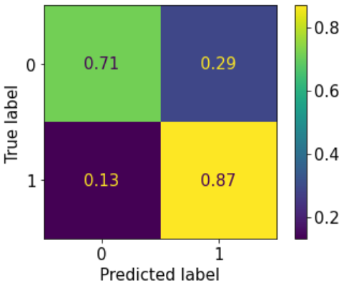
Voting Classifier
Accuracy: 0.74
AUROC: 0.79
Used logistic regression and nearest neighbors with all variables
Used gradient boosting with all variables
Used “soft” voting
Notes:
Emerie

Slide 22
Summary
Factors with highest coefficients are hemoglobin, gender, and UPC ratio
Ensembling the logistic regression, nearest neighbors, and gradient boosting models resulted in 74% accuracy
Ensembled model performed better than logistic regression and nearest neighbors alone
Gradient boosting alone performed slightly better than ensembled model at 77% accuracy
Notes:
Emerie

Slide 23
Thank You

Slide 24
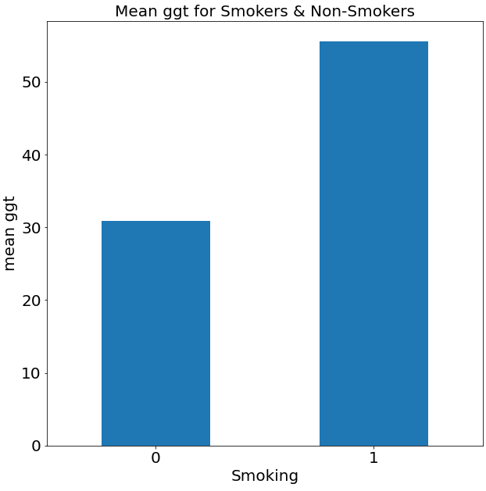
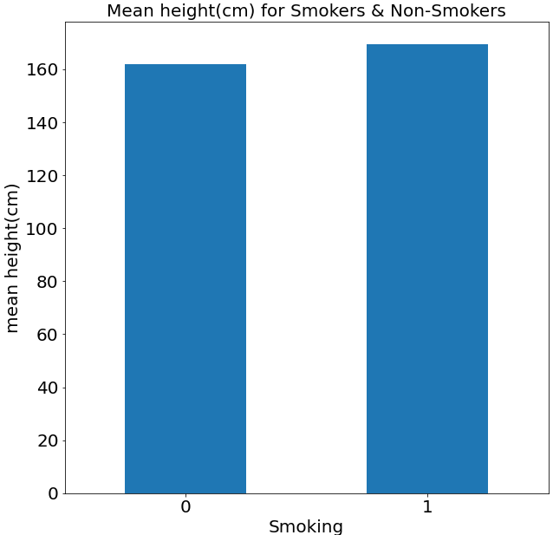
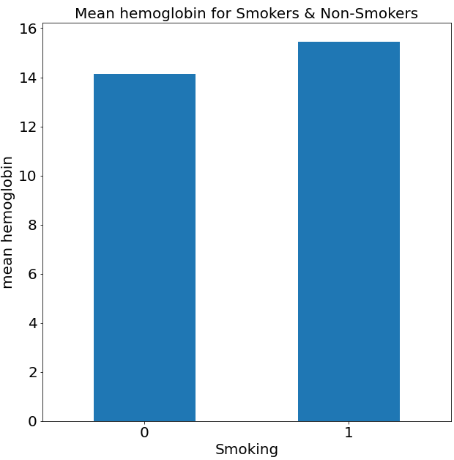
Comparing Smokers
& Non-Smokers
Slightly taller
Slightly higher hemoglobin
Higher GGT
Enzyme found in liver, high levels related to liver disease

Slide 25
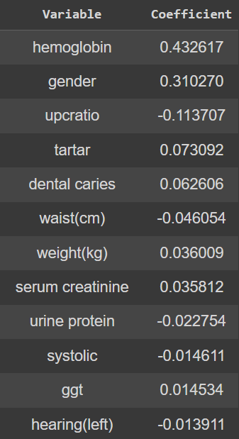
Assessing factors
Used the linear regression model to find coefficients for each variable
Hemoglobin, gender and UPC ratio were the most important factors
Used ±0.05 as the cutoff for models

Slide 26
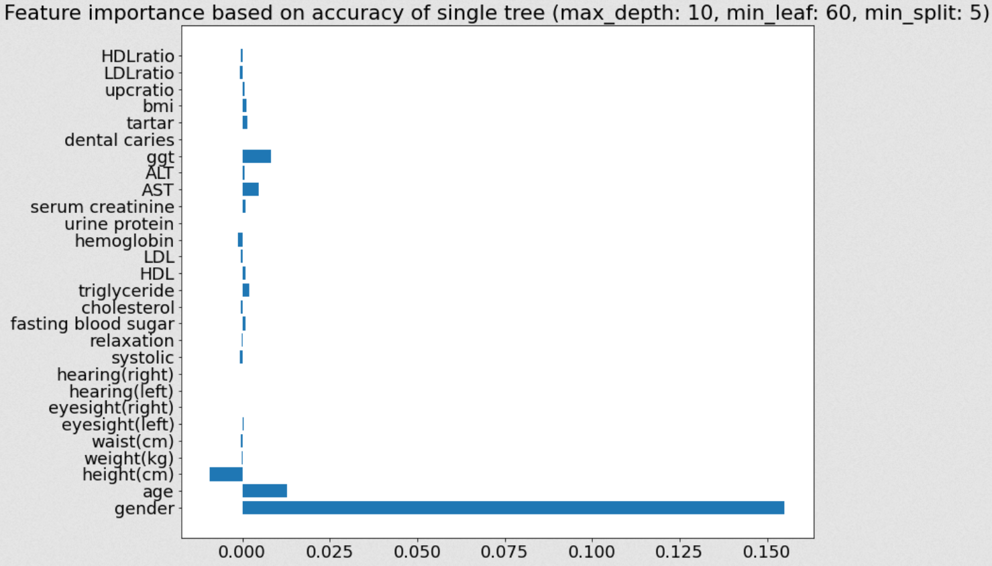
Feature importance via permutation and decision tree predictions - accuracy

Slide 27
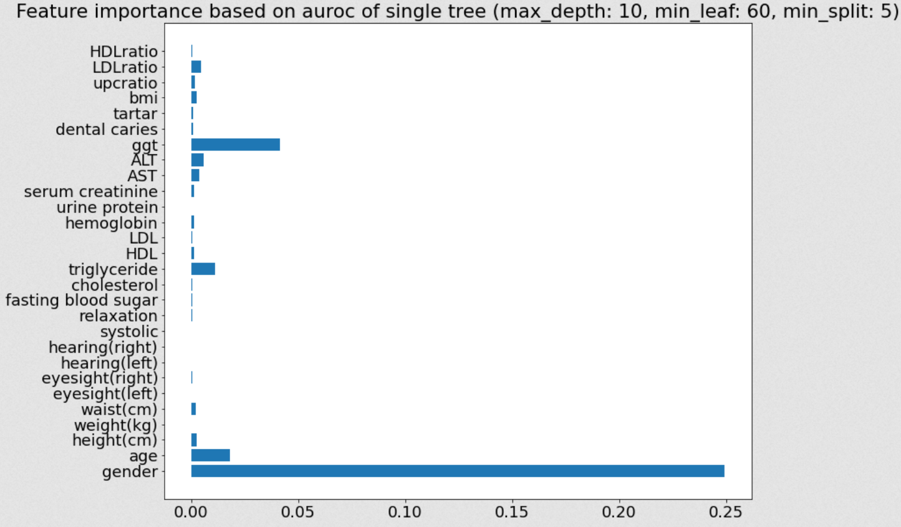
Feature importance via permutation and decision tree predictions - auroc

Slide 28
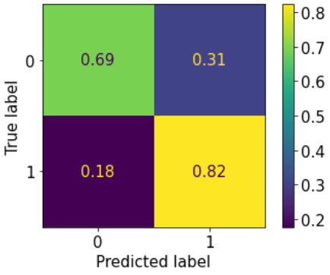
Voting Classifier
Accuracy: 0.72
AUROC: 0.76
Used logistic regression and nearest neighbors with all variables
Used gradient boosting with all variables
Used “hard” voting
Notes:
Emerie

Slide 29
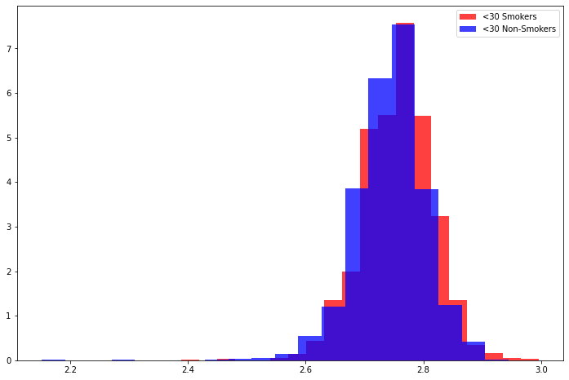
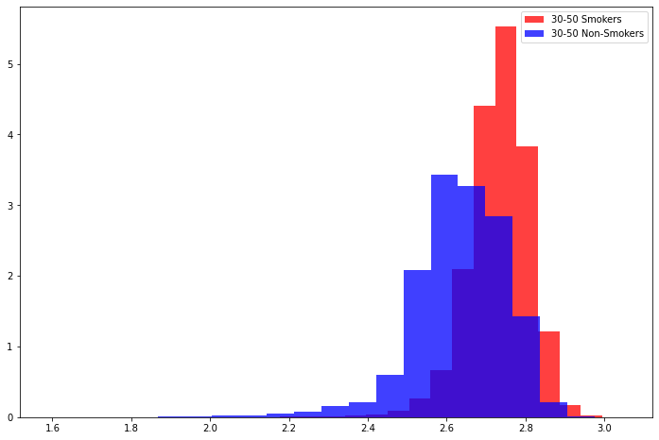
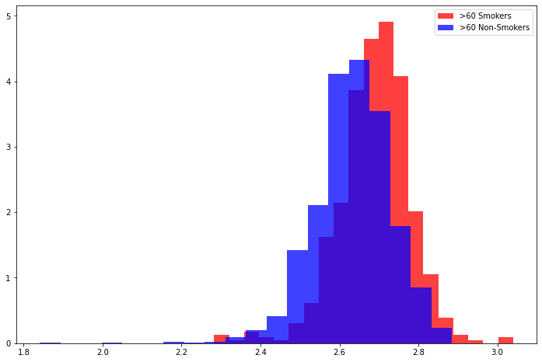
Age interactions

Slide 30
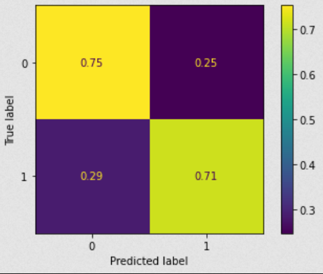
Initial Tree
70/30 train test split
Max depth = 5
Minimum samples split = 10
Minimum samples leaf = 5
Accuracy score: .738

